Slide 1

Movie rental analysis

Slide 2
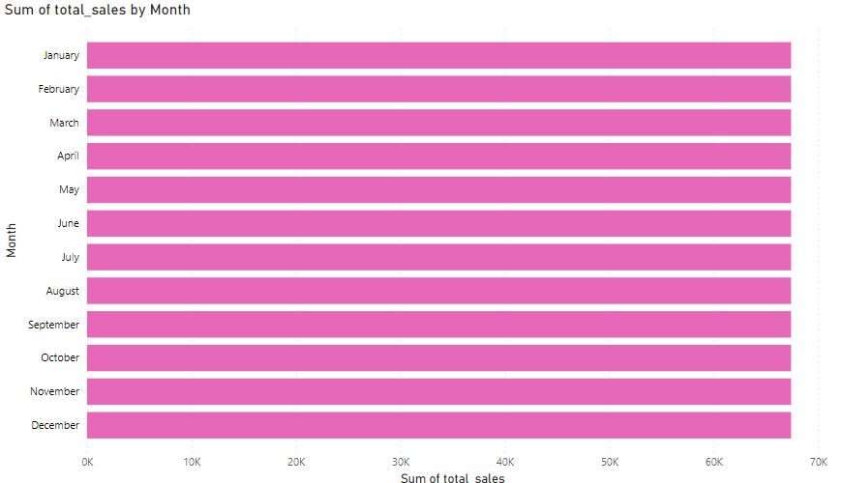
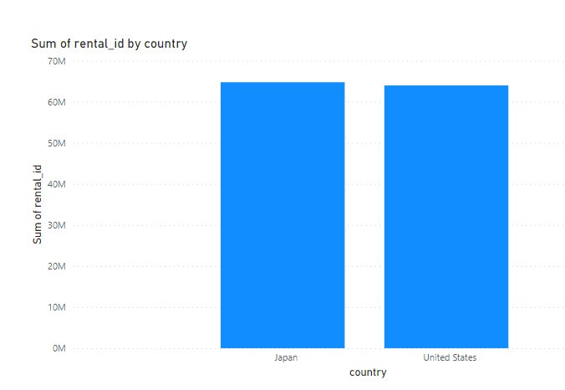
First of all by analyzing the total sales happened with respect to the following months has been shown using the above bar chart and top rentals happened based on the country has also been shown using the bar chart.

Slide 3
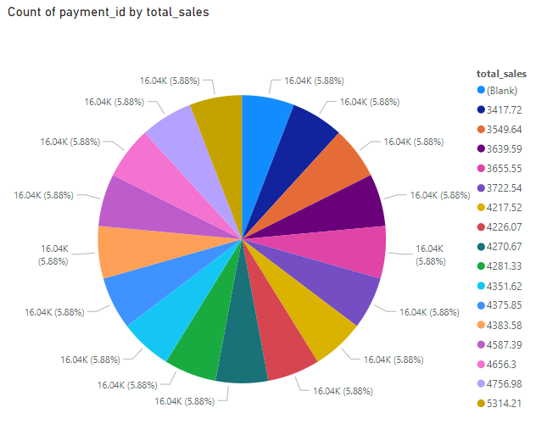
The count on number of payments made based on the sales happened in percentage to showcase the entire outcome of the entire progress on sales with respect to payments in the Pie chart.

Slide 4
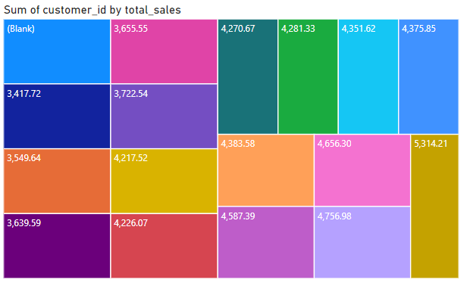
The total sales made by the respective customers is shown using the above tree chart to show in detail how many movies has been rented out for customers

Slide 5
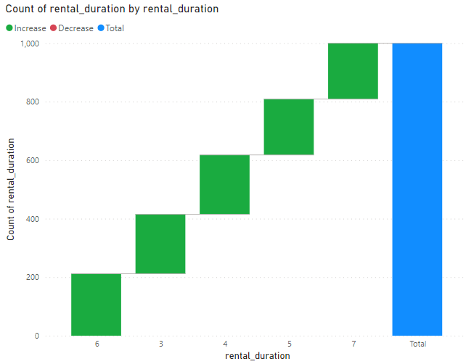
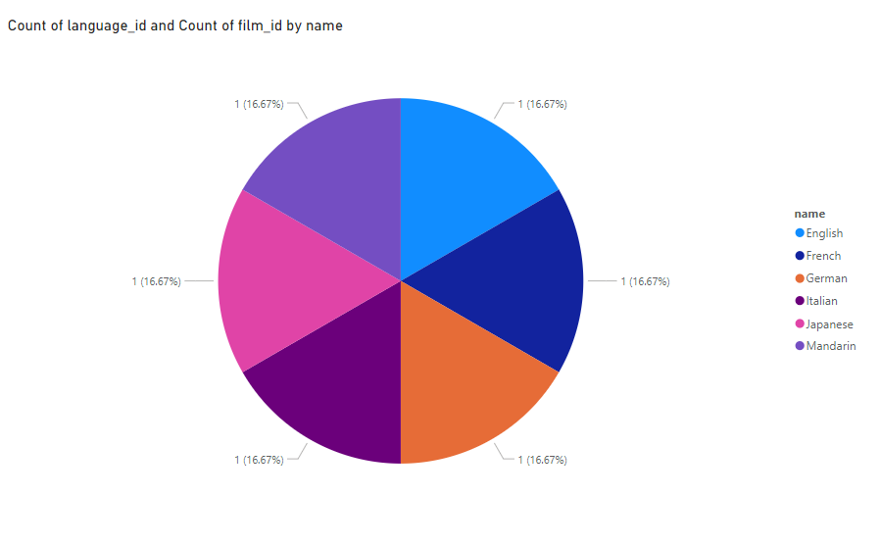
Rental duration and the number of counts of rental which also plays a major role which depicts the customers interest towards the movies with respect to this company which shows the customer loyalty and positive experience that increases the rentals for the company. Also count of film ID with respect to language are shown in the above pie chart since there are different types of languages of depicted in the given data.

Slide 6
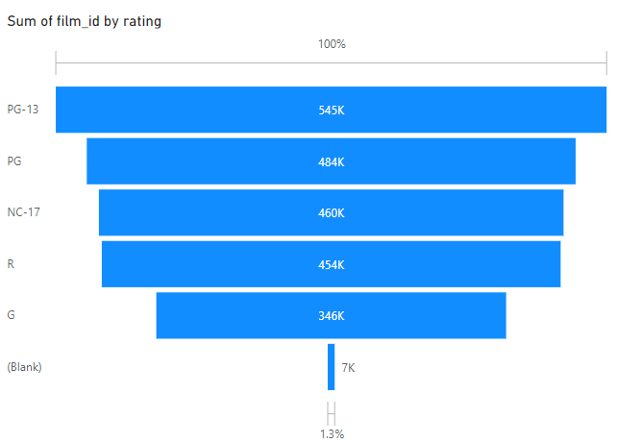
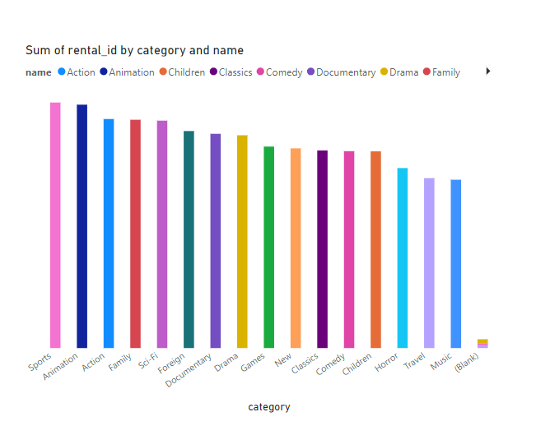
Since ratings are the most important credit given for a movie which helps the team and rental companies on what movies and types of it can be purchased and sold to customers to have a good customer experience also good sales and revenue for a successful growth. In the above charts the ratings with respect to movies and renatls based on category names and movie are shown above.

Slide 7
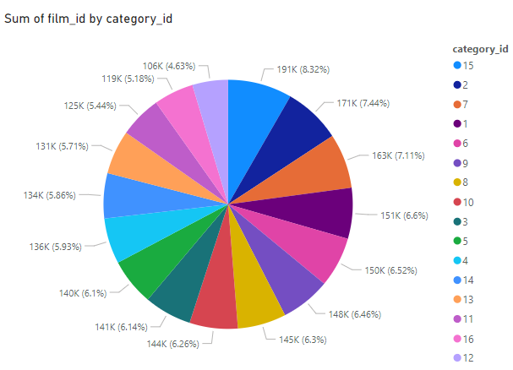
As to have a clear trend on the movies with respect to the categories and stated using the pie chart to have in and out insight towards the performance of the movies with respect to its categories it belong.
In general category is a basic trait to clearly understand the what’s the film is about and with regards to it the movies can be depicted to the right customers in order to increase sales/revenue.

Slide 8
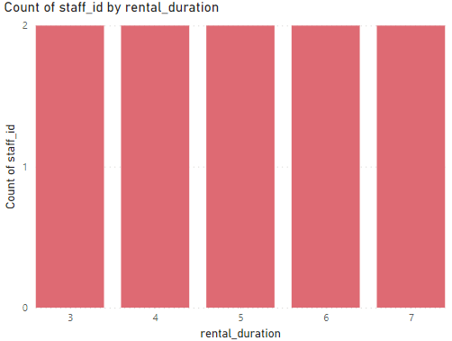
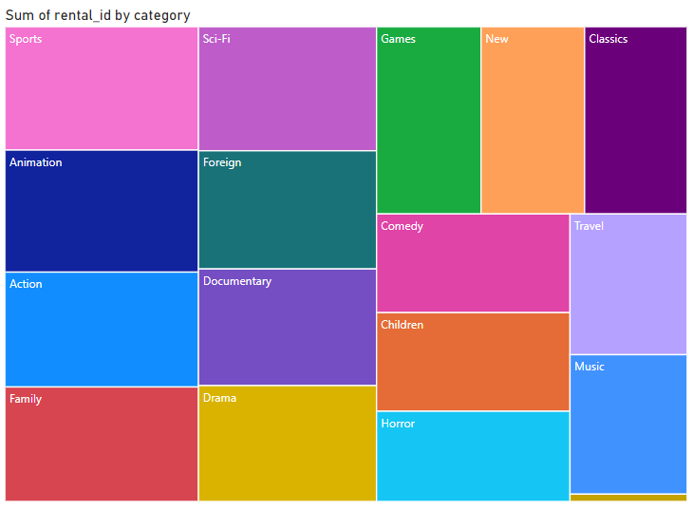
The count of sales with respect to the rental duration and rental trends with respect to the categories of movies can be depicted using the above charts in detail with clear and detailed visualization

Slide 9
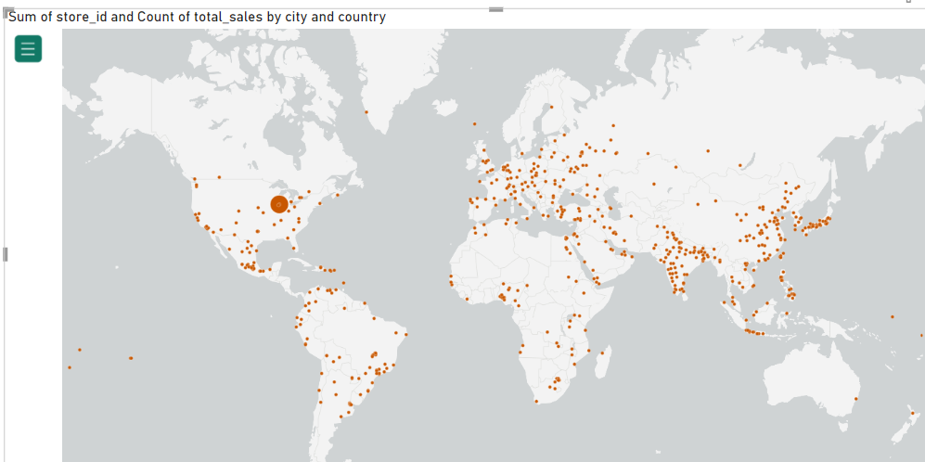
The total count of sales happened across different countries and cities are shown using the map view in detail for a easier and detail picturization to gather information and insights on it.

Slide 10
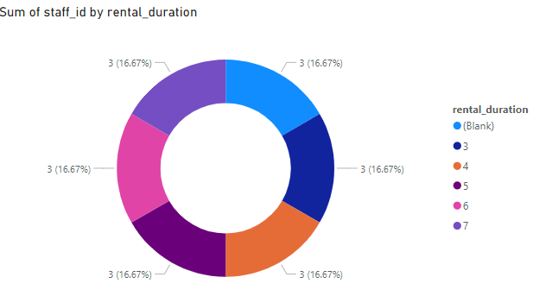
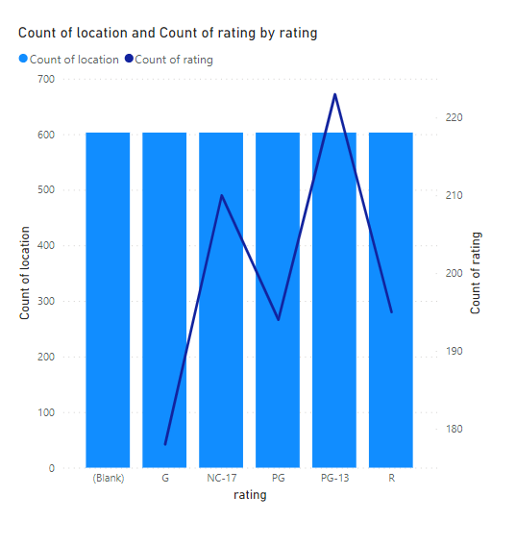
The above donut chart shows the rental durations happened with each and every staff which can be useful to find and analyze the staff performance and outcomes with the customer experience. Also the count of sales and count of ratings is shown which will be very helpful to find insights and analyze in detail dept information to improvise customer experience and movie rental methods to have a successful growth in all aspects.

Slide 11
Conclusion
To sum up, our analysis has provided valuable insights into the movie rental industry. These insights can guide businesses in making informed decisions for future strategies.

